Slide 1
Position Invariance

Slide 2
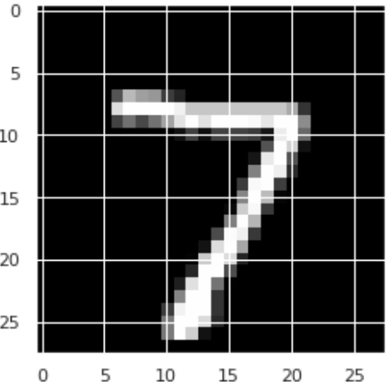
FFNN for Digits
def build_ffnn():
model = tf.keras.Sequential()
model.add(tf.keras.layers.Flatten())
model.add(tf.keras.layers.Dense(units=128, activation='relu'))
model.add(tf.keras.layers.Dense(units=128, activation='relu'))
model.add(tf.keras.layers.Dense(units=10, activation='softmax'))
model.compile(loss=tf.keras.losses.sparse_categorical_crossentropy,
optimizer='adam', metrics=['accuracy'])
return model
Notes:
How many parameters?

Slide 3
FFNN Training
Layer (type) Output Shape Param #
=================================================================
flatten (Flatten) (None, 784) 0
dense (Dense) (None, 128) 100480
dense_1 (Dense) (None, 128) 16512
dense_2 (Dense) (None, 10) 1290
=================================================================
Trainable params: 118,282
Epoch 1/3 loss: 0.2445 - accuracy: 0.9276 - val_loss: 0.1117 - val_accuracy: 0.9683
Epoch 2/3 loss: 0.1016 - accuracy: 0.9689 - val_loss: 0.0804 - val_accuracy: 0.9768
Epoch 3/3 loss: 0.0694 - accuracy: 0.9777 - val_loss: 0.0744 - val_accuracy: 0.9773
Notes:
output shape
params
loss & accuracy

Slide 4
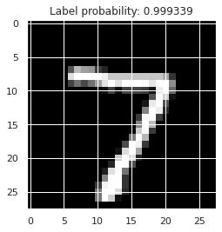
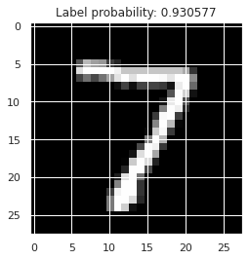
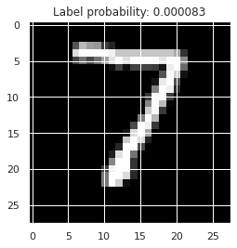
FFNN Inference Experiment
Notes:
model.predict(image) -> vector of probs
model.predict(image)[7]

Slide 5
CNN for Digits
def build_cnn():
model = tf.keras.Sequential()
model.add(tf.keras.layers.Conv2D(
filters=16, kernel_size=5, activation='relu', padding='valid'))
model.add(tf.keras.layers.MaxPooling2D(pool_size=2))
model.add(tf.keras.layers.Conv2D(
filters=16, kernel_size=3, activation='relu', padding='valid'))
model.add(tf.keras.layers.MaxPooling2D(pool_size=2))
model.add(tf.keras.layers.Flatten())
model.add(tf.keras.layers.Dense(units=10, activation='softmax'))
model.compile(loss=tf.keras.losses.sparse_categorical_crossentropy,
optimizer='adam', metrics=['accuracy'])
return model
Notes:
Don’t flatten initially
Conv2D & MaxPooling2D
Softmax layer is the same as before

Slide 6
CNN Training
Layer (type) Output Shape Param #
=================================================================
conv2d (Conv2D) (None, 24, 24, 16) 416
max_pooling (MaxPooling2D) (None, 12, 12, 16) 0
conv2d_1 (Conv2D) (None, 10, 10, 16) 2320
max_pooling_1 (MaxPooling) (None, 5, 5, 16) 0
flatten (Flatten) (None, 400) 0
dense (Dense) (None, 10) 4010
=================================================================
Trainable params: 6,746
Epoch 1/3 loss: 0.2510 - accuracy: 0.9249 - val_loss: 0.0755 - val_accuracy: 0.9798
Epoch 2/3 loss: 0.0809 - accuracy: 0.9754 - val_loss: 0.0612 - val_accuracy: 0.9823
Epoch 3/3 loss: 0.0625 - accuracy: 0.9813 - val_loss: 0.0502 - val_accuracy: 0.9870
Notes:
output shapes
~20x fewer params
better loss & accuracy

Slide 7



CNN Inference Experiment

Slide 8
CNNs
Learn groups of parameters (filters) that are used many times (parameter sharing)
Each filter looks for a pattern in the data and quantifies the response (filter map)
Focus on the most significant responses (max-pooling)

Slide 9
Position Invariance
Notes:
Q: [True/False] Position Invariance refers to the fact that an object in different orientations remains the same object.
A: True

Slide 10
Convolutional Filters

Slide 11
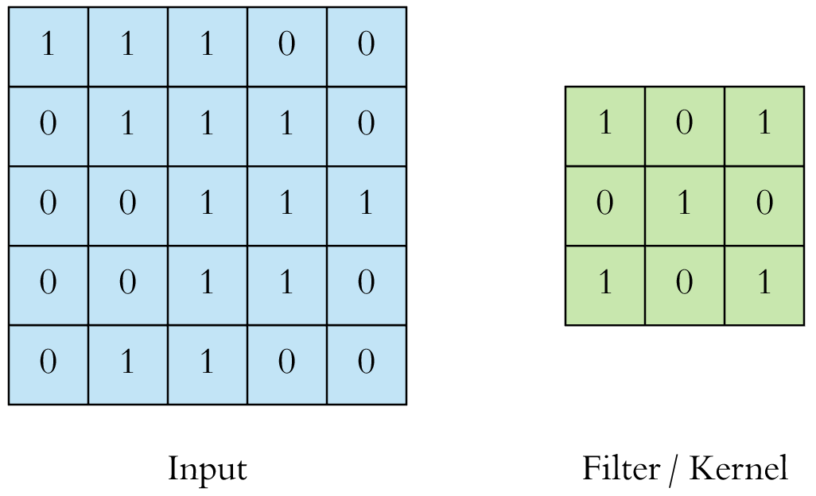
Convolution
[source]

Slide 12
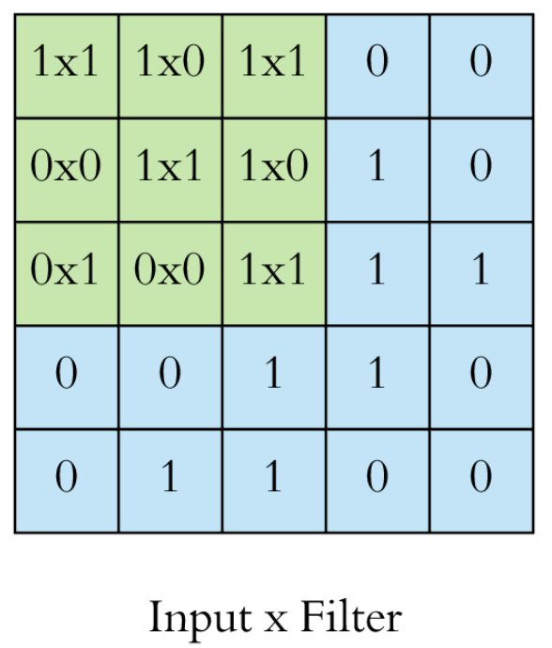
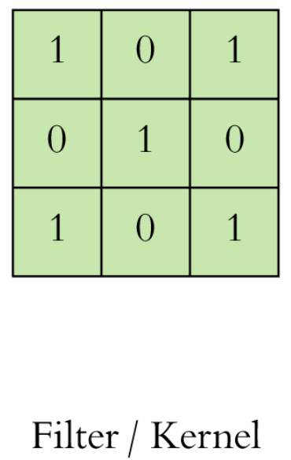
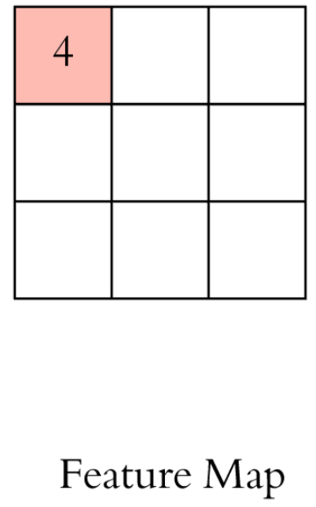
Convolution
[source]
Notes:
Filter size = k
Input size = n
Feature map size = k-n+1
Unless we add padding to the input

Slide 13
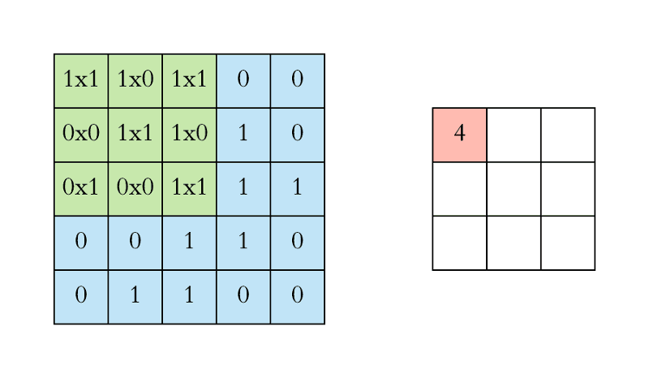
Convolution
[source]

Slide 14
Parameterized Filters
[source]
Notes:
filter parameters (and bias)

Slide 15
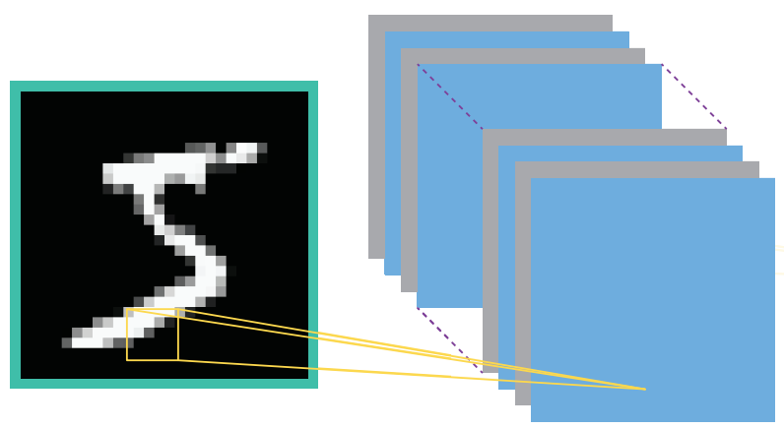
Multiple Filters
Each filter learns to recognize a pattern
Patterns are encoded in the filter parameters
We want many filters
[source]

Slide 16
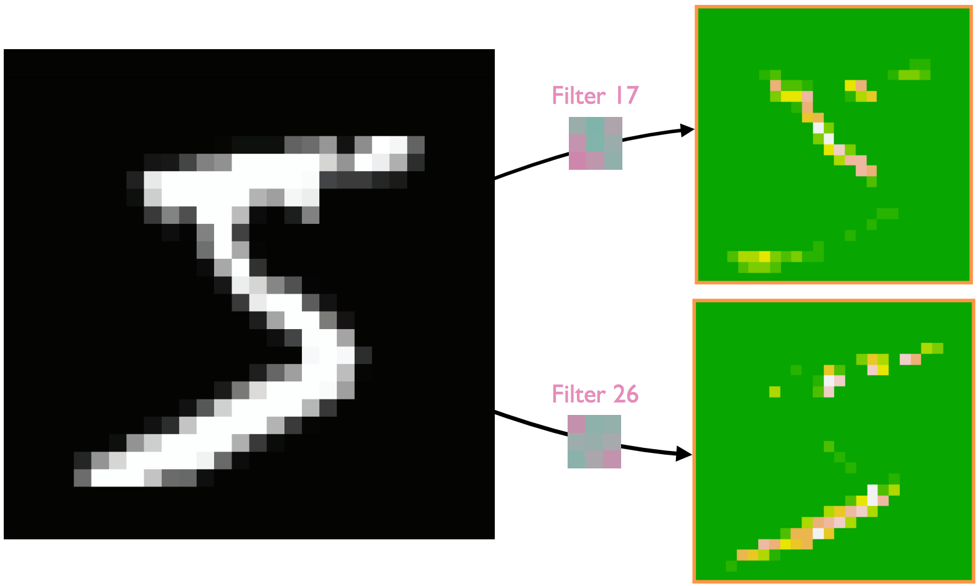
Multiple Filters
Each filter learns to recognize a pattern
Patterns are encoded in the filter parameters
We want many filters
[source]
tf.keras.layers.Conv2D(filters=32, kernel_size=3, activation='relu', padding='valid')

Slide 17

Channels
A grayscale image just has a single color channel
But a color image has 3 color channels (RGB)
A convolutional filter has a depth (here: 3x3x3)
[source]

Slide 18

Example: 3 Channels
[source]

Slide 19
Conv2D in Keras
image = X_test[0:1] # (1, 28, 28, 1)
conv = tf.keras.layers.Conv2D(filters=32, kernel_size=5, activation='relu', padding='valid')
print('Filter map shape:', conv(image).shape)
weights, biases = conv.get_weights()
print('Filter shape:', weights.shape)
print('Biases:', biases.shape)
> Filter map shape: (1, 24, 24, 32)
> Filter shape: (5, 5, 1, 32)
> Biases: (32,)

Slide 20
Convolutional Filters
Notes:
Q: [True/False] A convolutional filter is applied in exactly one location in an input image.
A: False

Slide 21
Convolutional Model Layers

Slide 22

Pooling
[source]

Slide 23
Pooling
After 1+ convolution layers, pooling reduces dimensionality
Max-pooling highlights the largest response for each filter
Adds some scale invariance
[source]

Slide 24
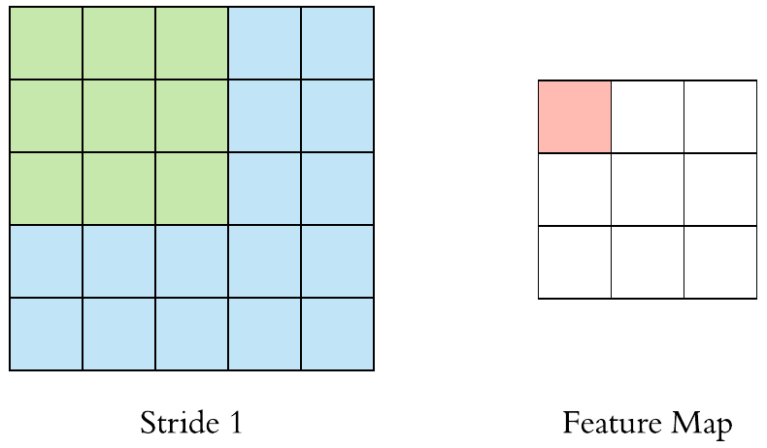
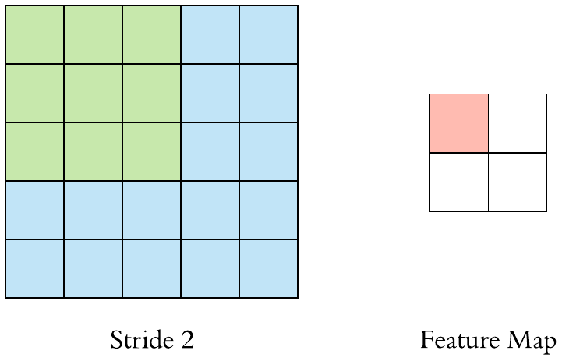
Stride
[source]

Slide 25
Stride
Larger strides will often:
Reduce correlation between outputs
Reduce model size
Limit over-fitting
For convolution, set stride to 1
For pooling, set stride to 2
[source]

Slide 26
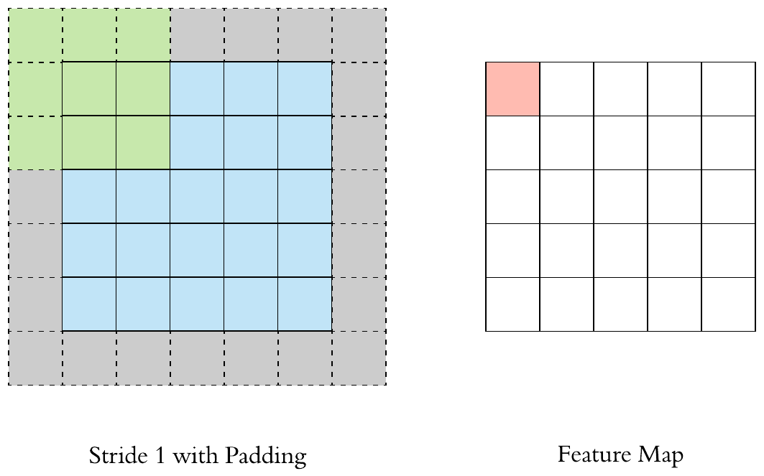
Padding
Padding helps preserve borders
And matches input/output shape
[source]
Notes:
padding = ‘valid’ : no padding
padding = ‘same’: make the output dimension match the input dimension

Slide 27
MNIST CNN
def build_cnn():
model = tf.keras.Sequential()
model.add(tf.keras.layers.Conv2D(
filters=16, kernel_size=5, activation='relu', padding='valid'))
model.add(tf.keras.layers.MaxPooling2D(pool_size=2))
model.add(tf.keras.layers.Conv2D(
filters=16, kernel_size=3, activation='relu', padding='valid'))
model.add(tf.keras.layers.MaxPooling2D(pool_size=2))
model.add(tf.keras.layers.Flatten())
model.add(tf.keras.layers.Dense(units=10, activation='softmax'))
model.compile(loss=tf.keras.losses.sparse_categorical_crossentropy,
optimizer='adam', metrics=['accuracy'])
return model

Slide 28
Assembling a CNN
Layer (type) Output Shape Param #
=================================================================
conv2d (Conv2D) (None, 24, 24, 16) 416
max_pooling (MaxPooling) (None, 12, 12, 16) 0
conv2d_1 (Conv2D) (None, 10, 10, 16) 2320
max_pooling_1 (MaxPooling) (None, 5, 5, 16) 0
flatten (Flatten) (None, 400) 0
dense (Dense) (None, 10) 4010
=================================================================
Trainable params: 6,746
Notes:
((5 x 5) + 1) x 16
((3 x 3 x 16) + 1) x 16
(400 + 1) x 10

Slide 29
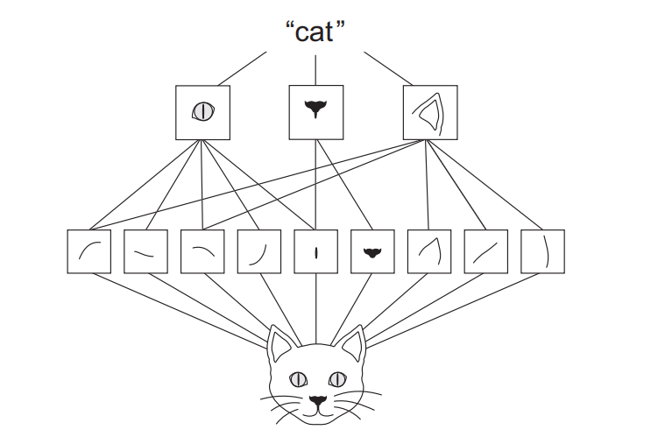
Stacking Convolutions

Slide 30
Convolutional Model Layers
Notes:
Q: [True/False] Max-pooling with stride 2 applied to an input with shape (32, 32, 8) would produce an output with shape (16, 16, 4).
A: False; correct shape: (16, 16, 8)

Slide 31
Comparing Computation

Slide 32
FFNN vs CNN Computation
Layer (type) Output Shape Param #
=========================================================
flatten (Flatten) (None, 784) 0
dense (Dense) (None, 128) 100480
dense_1 (Dense) (None, 128) 16512
dense_2 (Dense) (None, 10) 1290
=========================================================
Trainable params: 118,282

Slide 33
FFNN vs CNN Computation
Layer (type) Output Shape Param #
=========================================================
flatten (Flatten) (None, 784) 0
dense (Dense) (None, 128) 100480
dense_1 (Dense) (None, 128) 16512
dense_2 (Dense) (None, 10) 1290
=========================================================
Trainable params: 118,282
(28 x 28 x 128) + 128
+ (128 x 128) + 128
+ (128 x 10) + 10
------------------------
= 118282

Slide 34
FFNN vs CNN Computation
Layer (type) Output Shape Param #
=========================================================
flatten (Flatten) (None, 784) 0
dense (Dense) (None, 128) 100480
dense_1 (Dense) (None, 128) 16512
dense_2 (Dense) (None, 10) 1290
=========================================================
Trainable params: 118,282
(28 x 28 x 128) + 128
+ (128 x 128) + 128
+ (128 x 10) + 10
------------------------
= 118282
Layer (type) Output Shape Param #
=========================================================
conv2d (Conv2D) (None, 24, 24, 16) 416
max_pooling (MaxPooling2D) (None, 12, 12, 16) 0
conv2d_1 (Conv2D) (None, 10, 10, 16) 2320
max_pooling_1 (MaxPooling) (None, 5, 5, 16) 0
flatten (Flatten) (None, 400) 0
dense (Dense) (None, 10) 4010
=========================================================
Trainable params: 6,746

Slide 35
FFNN vs CNN Computation
Layer (type) Output Shape Param #
=========================================================
flatten (Flatten) (None, 784) 0
dense (Dense) (None, 128) 100480
dense_1 (Dense) (None, 128) 16512
dense_2 (Dense) (None, 10) 1290
=========================================================
Trainable params: 118,282
(28 x 28 x 128) + 128
+ (128 x 128) + 128
+ (128 x 10) + 10
------------------------
= 118282
Layer (type) Output Shape Param #
=========================================================
conv2d (Conv2D) (None, 24, 24, 16) 416
max_pooling (MaxPooling2D) (None, 12, 12, 16) 0
conv2d_1 (Conv2D) (None, 10, 10, 16) 2320
max_pooling_1 (MaxPooling) (None, 5, 5, 16) 0
flatten (Flatten) (None, 400) 0
dense (Dense) (None, 10) 4010
=========================================================
Trainable params: 6,746
((5 x 5 x 1) + 1) x (24 x 24) x 16
+ ((3 x 3 x 16) + 1) x (10 x 10) x 16
+ (400 x 10) + 10
--------------------------------------
= 239616 + 232000 + 4010
= 475626

Slide 36
Comparing Computation
Notes:
Q: [True/False] A CNN typically involves more operations than it has parameters because each filter is applied many times.
A: True

Slide 37
ImageNet

Slide 38
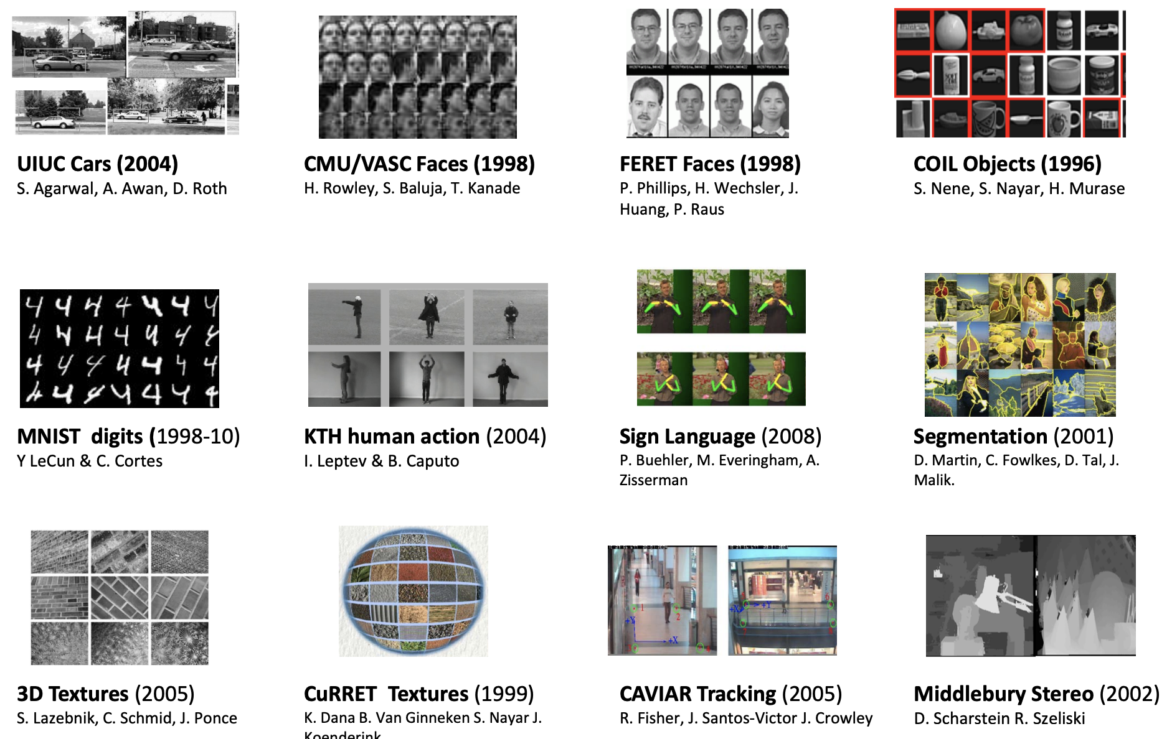
Image Datasets
Pre-2010 datasets were fairly small and specific
Collecting and labeling lots of data is hard

Slide 39
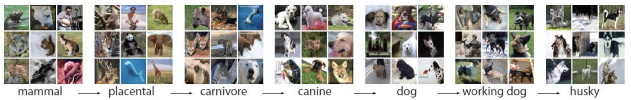
Data Collection
Start with a taxonomy of objects
Notes:
from wordnet

Slide 40
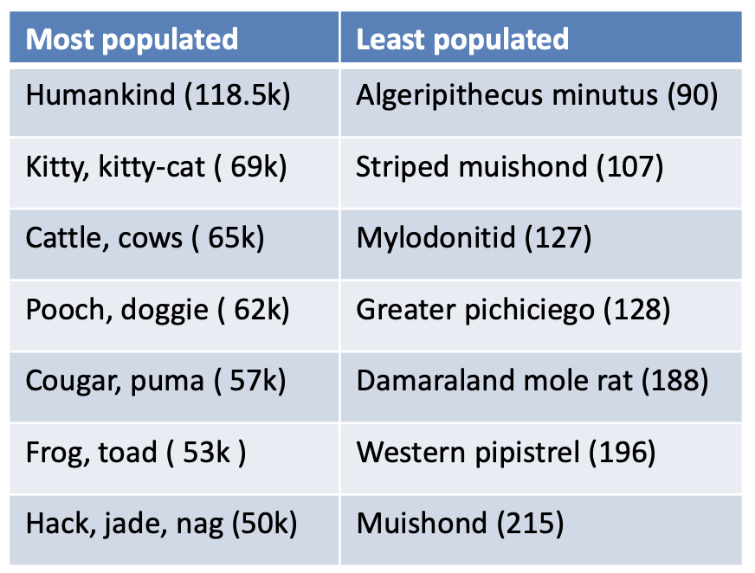
Data Collection
Start with a taxonomy of objects
Search the internet for images in each category

Slide 41
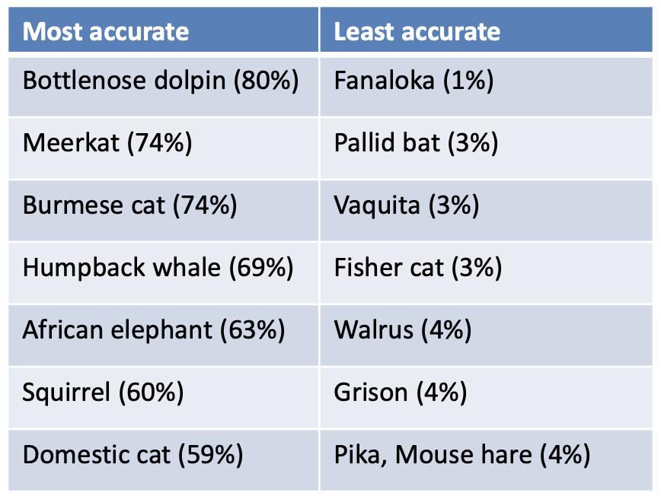
Data Collection
Start with a taxonomy of objects
Search the internet for images in each category
Ask students to validate the images

Slide 42
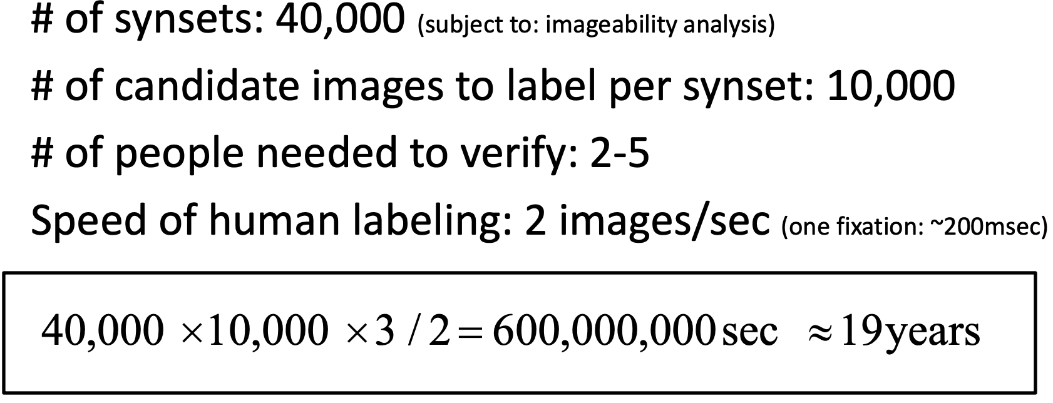
Data Collection
Start with a taxonomy of objects
Search the internet for images in each category
Ask students to validate the images
Time estimate… 19 years

Slide 43
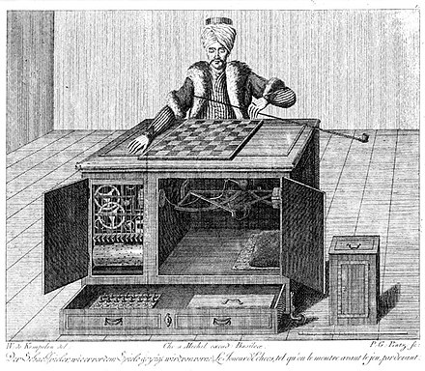

Mechanical Turk

Slide 44
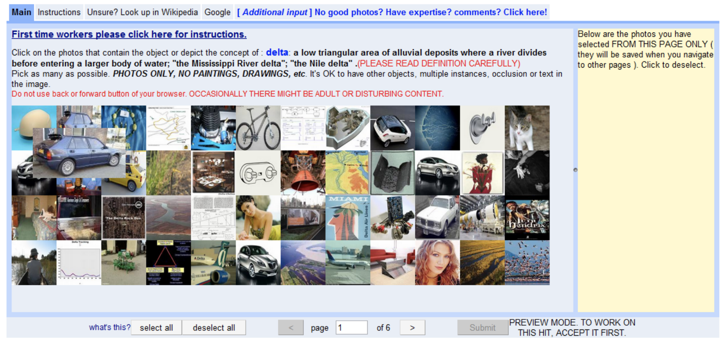
Mechanical Turk UI

Slide 45
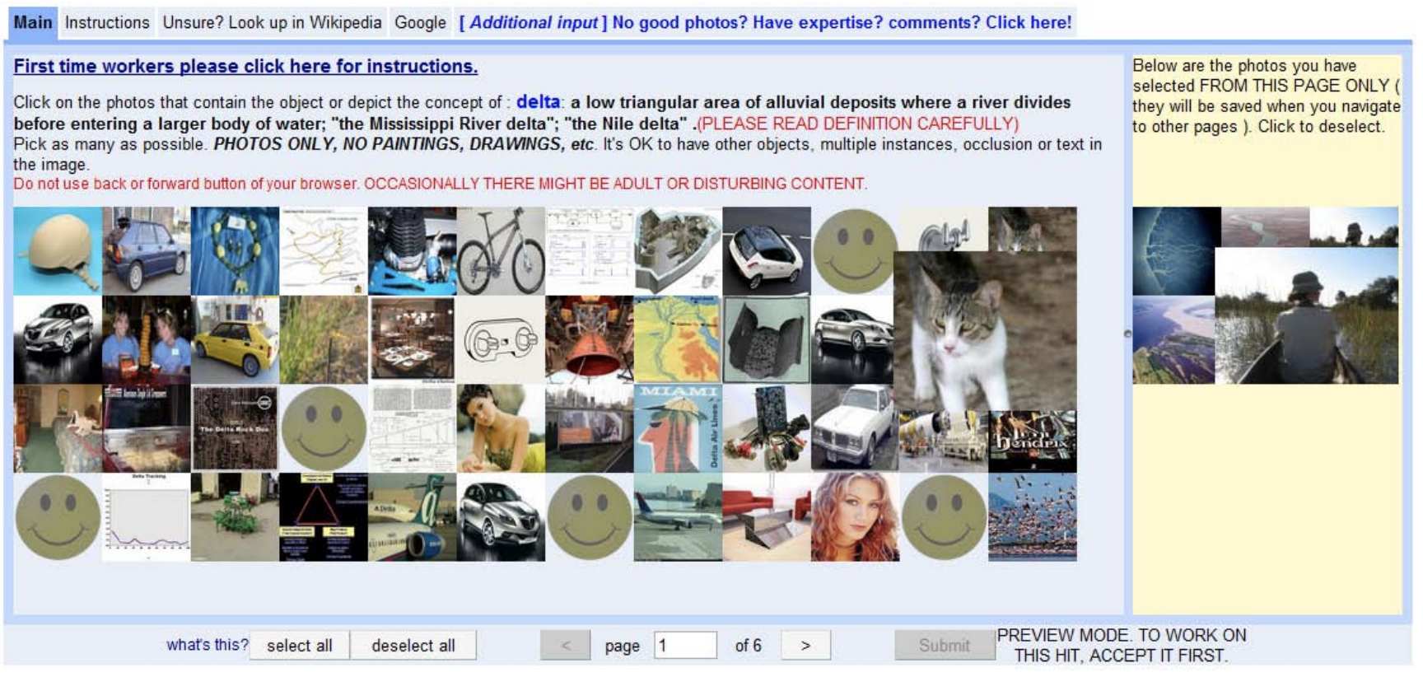
Mechanical Turk UI

Slide 46
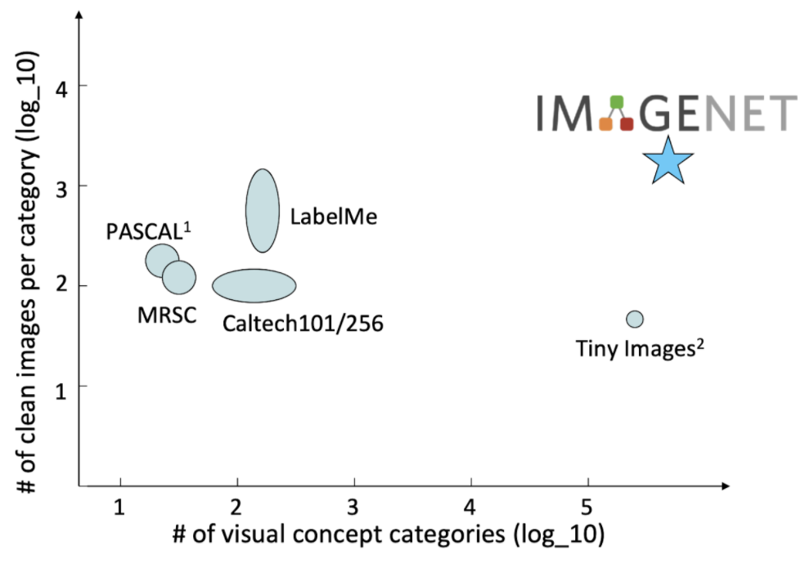
ImageNet is Big
July 2008: 0 images
Dec 2008: 3M images; 6K categories
April 2010: 11M images; 15K categories
Notes:
age of big data arrives

Slide 47
ImageNet
Notes:
Q: [True/False] ImageNet annotations are guaranteed to be 100% correct.
A: False

Slide 48
Breakthrough Results

Slide 49
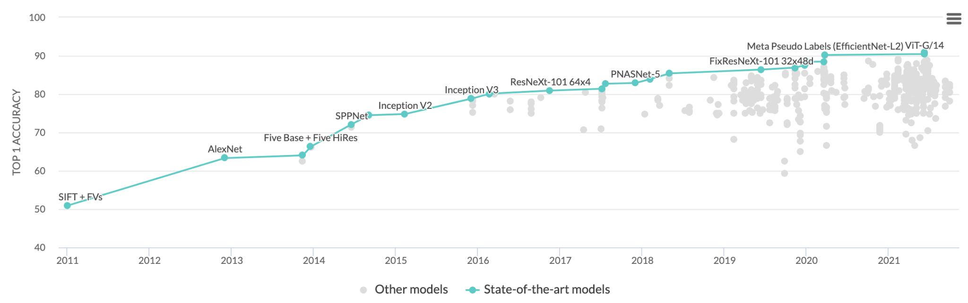
Accuracy over Time
[source]

Slide 50
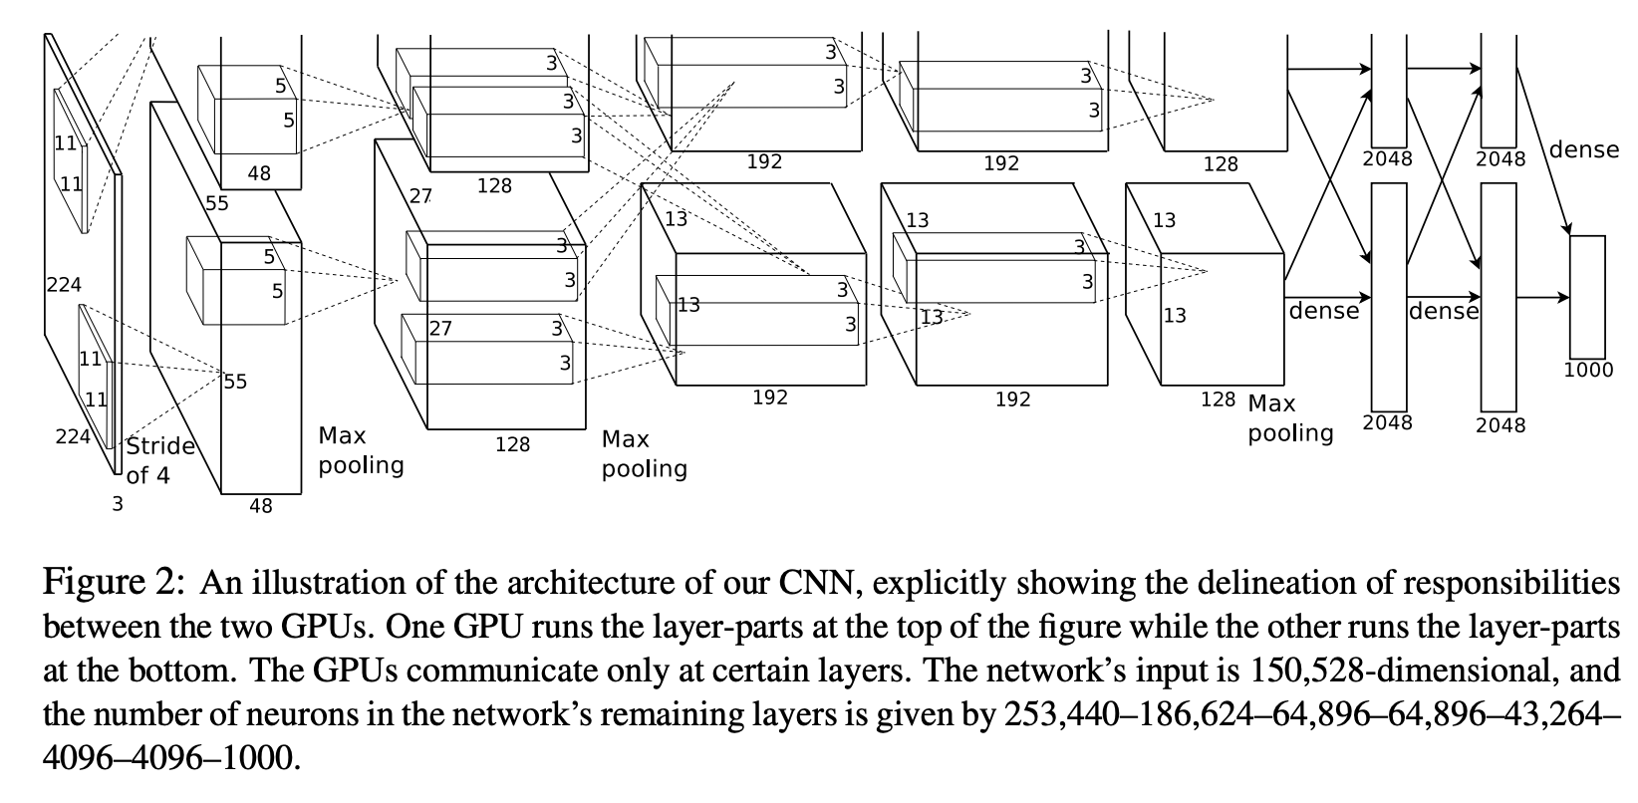
AlexNet Architecture
[source]

Slide 51
AlexNet Details
5 Layer CNN (60M parameters)
ReLU activations
Trained on 2 GPUs for a week
Data Augmentation: (256 x 256) → (224 x 224)
Optimizer: SGD with Momentum

Slide 52
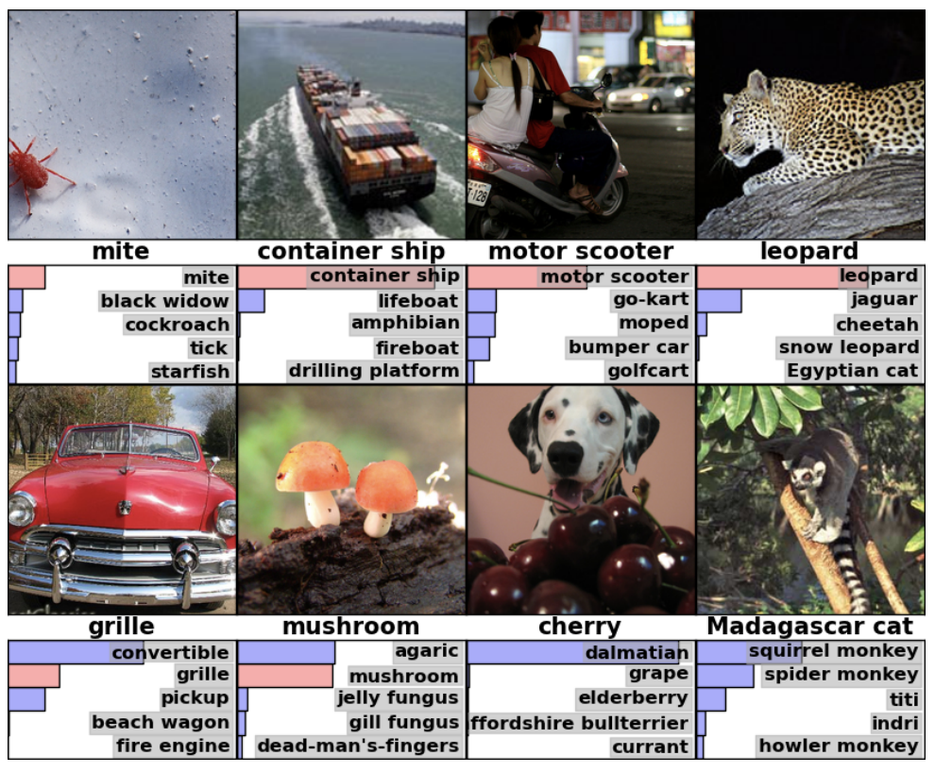
Sample Outputs

Slide 53
Breakthrough Results
Notes:
Q: [True/False] The data augmentation strategy is to simply duplicate the training images.
A: False

Slide 54
CNNs for Text and CT Scans

Slide 55
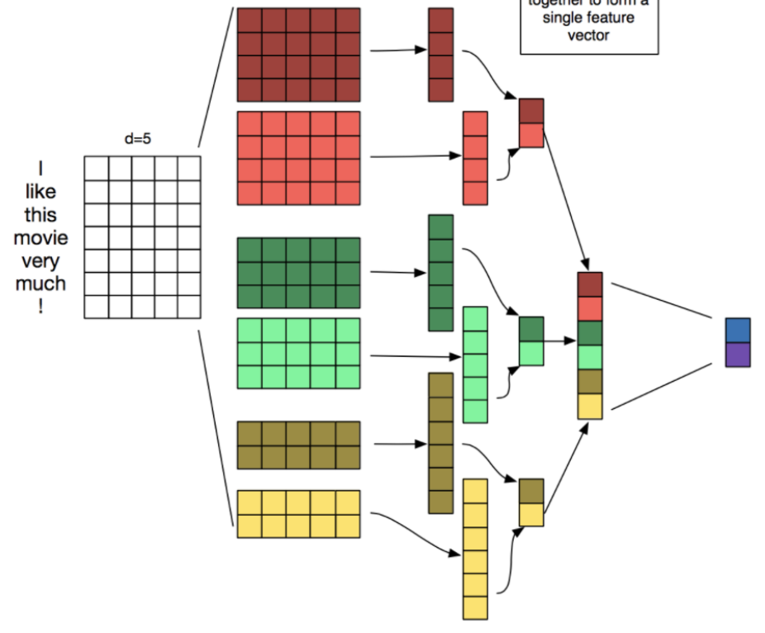
CNN for Text
Each filter looks for n-gram patterns
Max-pooling over the whole input
Use Conv1D and MaxPooling1D operators
embeddings
conv filters
feature maps
max pool
concat
softmax

Slide 56
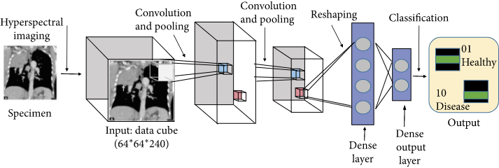
CNN for CT Scans
CT Scans have many slices – 3D images
Use Conv3D and MaxPooling3D operators

Slide 57
CNNs for Text and CT Scans
Notes:
Q: [True/False] It would be impossible to apply a Conv-2D operator to text.
A: False

